Slide 1
Operations Management
William J. Stevenson
8th edition

Slide 2
CHAPTER
10
Quality Control
Operations Management, Eighth Edition, by William J. Stevenson
Copyright © 2005 by The McGraw-Hill Companies, Inc. All rights reserved.
McGraw-Hill/Irwin

Slide 3
Phases of Quality Assurance
Figure 10.1
Inspection and
corrective
action during
production
Inspection
before/after
production
Quality built
into the
process
Acceptance
sampling
Process
control
Continuous
improvement
The least
progressive
The most
progressive

Slide 4
Inspection
Figure 10.2
How Much/How Often
Where/When
Centralized vs. On-site
Inputs
Transformation
Outputs
Acceptance
sampling
Process
control
Acceptance
sampling

Slide 5
Inspection Costs
Figure 10.3
Cost
Total Cost
Cost of
inspection
Cost of
passing
defectives
Optimal
Amount of Inspection

Slide 6
Where to Inspect in the Process
Raw materials and purchased parts
Finished products
Before a costly operation
Before an irreversible process
Before a covering process

Slide 7
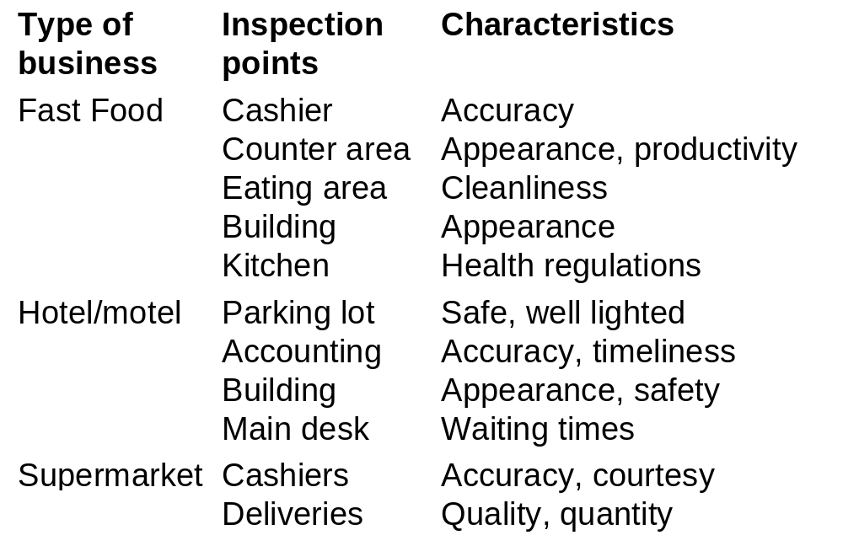
Examples of Inspection Points
Table 10.1

Slide 8
Statistical Process Control:
Statistical evaluation of the output of a process during production
Quality of Conformance:
A product or service conforms to specifications

Slide 9
Control Chart
Control Chart
  Purpose: to monitor process output to see if it is random
  A time ordered plot representative sample statistics obtained from an on going process (e.g. sample means)
  Upper and lower control limits define the range of acceptable variation

Slide 10
Statistical Process Control
Variations and Control
  Random variation: Natural variations in the output of a process, created by countless minor factors
  Assignable variation: A variation whose source can be identified

Slide 11
Control Chart
Figure 10.4
Abnormal variation
due to assignable sources
Out of
control
UCL
Mean
Normal variation
due to chance
LCL
Abnormal variation
due to assignable sources
0
1
2
3
4
5
6
7
8
9
10
11
12
13
14
15
Sample number

Slide 12
Statistical Process Control
The essence of statistical process control is to assure that the output of a process is random so that future output will be random.

Slide 13
Statistical Process Control
The Control Process
  Define
  Measure
  Compare
  Evaluate
  Correct
  Monitor results

Slide 14
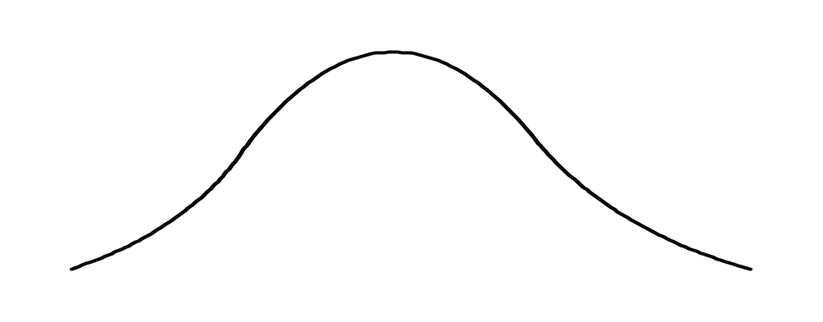
Normal Distribution
Figure 10.6
σ = Standard deviation
−3σ
−2σ
+2σ
+3σ
Mean
95.44%
99.74%

Slide 15


Sampling Distribution
Figure 10.5
Sampling
distribution
Process
distribution
Mean

Slide 16
Control Limits
Figure 10.7
Sampling
distribution
Process
distribution
Mean
Lower
control
limit
Upper
control
limit

Slide 17
SPC Errors
Type I error
  Concluding a process is not in control when it actually is.
Type II error
  Concluding a process is in control when it is not.

Slide 18
Type I Error
Figure 10.8
α/2
α/2
Mean
α = Probability
of Type I error
LCL
UCL

Slide 19
Observations from Sample Distribution
Figure 10.9
UCL
LCL
1
2
3
4
Sample number

Slide 20
Control Charts for Variables
Variables generate data that are measured.
Mean control charts
  Used to monitor the central tendency of a process.
  X bar charts
Range control charts
  Used to monitor the process dispersion
  R charts

Slide 21
Mean and Range Charts
Figure 10.10A
(process mean is
shifting upward)
Sampling
Distribution
UCL
x-Chart
Detects shift
LCL
UCL
Does not
detect shift
R-chart
LCL

Slide 22
Mean and Range Charts
Figure 10.10B
Sampling
Distribution
(process variability is increasing)
UCL
x-Chart
Does not
reveal increase
LCL
UCL
R-chart
Reveals increase
LCL

Slide 23
Name | Symbols | Control limits
 |  | X

Slide 24
Control Chart for Attributes
p-Chart - Control chart used to monitor the proportion of defectives in a process
c-Chart - Control chart used to monitor the number of defects per unit
Attributes generate data that are counted.

Slide 25
Use of p-Charts
Table 10.3
When observations can be placed into two categories.
  Good or bad
  Pass or fail
  Operate or don’t operate
When the data consists of multiple samples of several observations each

Slide 26
Use of c-Charts
Table 10.3
Use only when the number of occurrences per unit of measure can be counted; non-occurrences cannot be counted.
  Scratches, chips, dents, or errors per item
  Cracks or faults per unit of distance
  Breaks or Tears per unit of area
  Bacteria or pollutants per unit of volume
  Calls, complaints, failures per unit of time

Slide 27
Use of Control Charts
At what point in the process to use control charts
What size samples to take
What type of control chart to use
  Variables
  Attributes

Slide 28
Run Tests
Run test – a test for randomness
Any sort of pattern in the data would suggest a non-random process
All points are within the control limits - the process may not be random

Slide 29
Nonrandom Patterns in Control charts
Figure 10.11
Trend
Cycles
Bias
Mean shift
Too much dispersion

Slide 30
Counting Runs
Figure 10.12
Counting Above/Below Median Runs (7 runs)
B A A B A B B B A A B
Figure 10.13
Counting Up/Down Runs (8 runs)
U U D U D U D U U D

Slide 31
Process Capability
Tolerances or specifications
  Range of acceptable values established by engineering design or customer requirements
Process variability
  Natural variability in a process
Process capability
  Process variability relative to specification

Slide 32

Process Capability
Figure 10.15
Lower
Specification
Upper
Specification
A. Process variability
matches specifications
Lower
Specification
Upper
Specification
B. Process variability
well within specifications
Lower
Specification
Upper
Specification
C. Process variability
exceeds specifications

Slide 33
Process Capability Ratio
specification width
process width
Process capability ratio, Cp =
Upper specification – lower specification
6σ
Cp =

Slide 34
3 Sigma and 6 Sigma Quality
Lower
specification
Upper
specification
1350 ppm
1350 ppm
1.7 ppm
1.7 ppm
Process
mean
+/- 3 Sigma
+/- 6 Sigma

Slide 35
Improving Process Capability
Simplify
Standardize
Mistake-proof
Upgrade equipment
Automate

Slide 36
Taguchi Loss Function
Figure 10.17
Traditional
cost function
Cost
Taguchi
cost function
Lower
spec
Target
Upper
spec

Slide 37
Limitations of Capability Indexes
Process may not be stable
Process output may not be normally distributed
Process not centered but C_{p} is used

